Slide 1
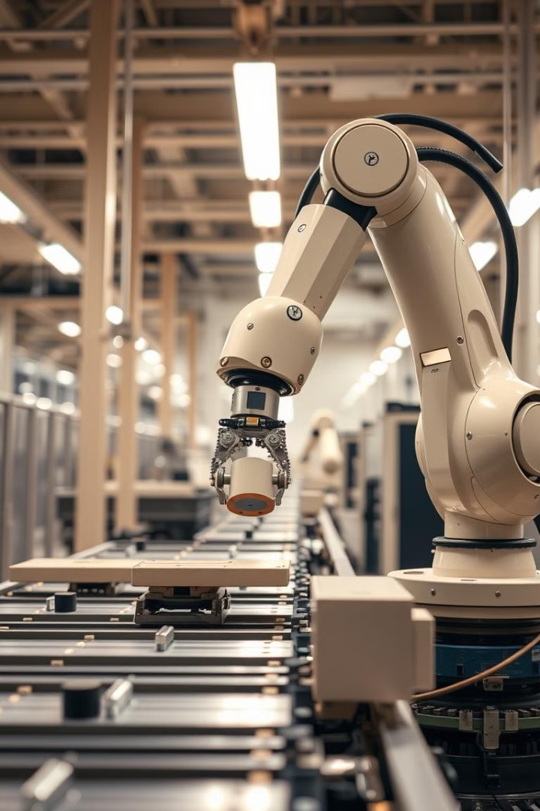
Concept of Quality
Group Members:
Muhammad Usman Qureshi
Zainab Saeed

Slide 2
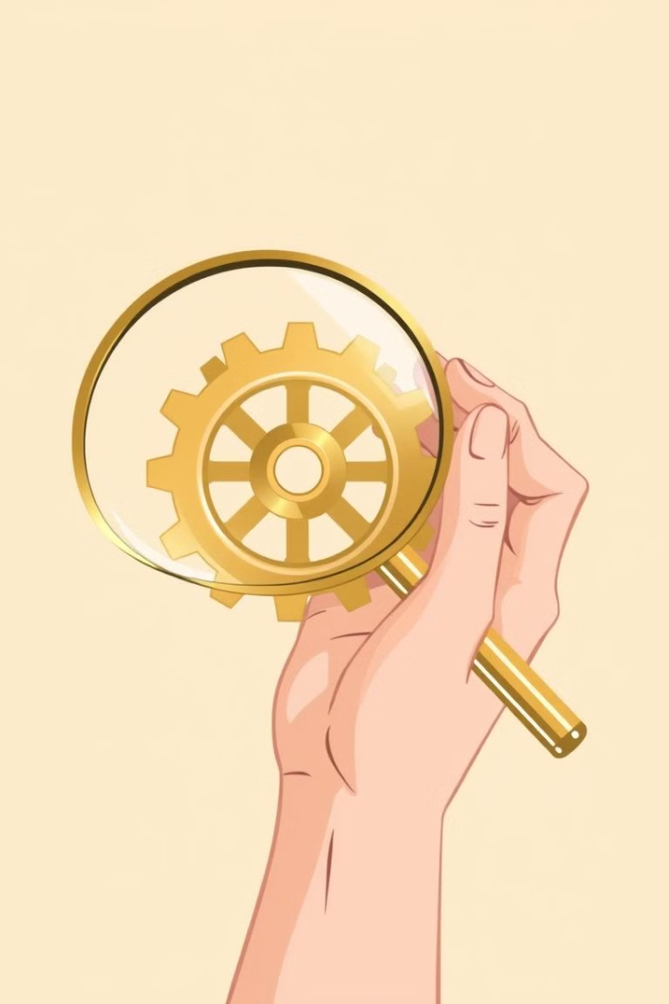
What is Quality?
Quality is how good or bad something is. It tells us if a product or service meets high standards.
Good quality means things work well and last long. It means customers get what they expect and feel happy with what they bought.
We can see quality in simple ways: Does the product break easily? Does it do its job well? Do people like using it?
For businesses, quality means doing things right from the start and keeping their promises to customers.

Slide 3



Feature-Based Quality
Features
Benefits
User Experience
Features are the things a product can do. They are the parts and functions that make it work and help people use it.
Benefits are what people get from the features. They show how the product helps people do things better or faster.
This is how it feels to use the product. Good products are easy to use and make people happy when they use them.

Slide 4




Performance-Based Quality
Performance-based quality shows how well something works when people use it. It looks at simple things we can measure. These measurements tell us if a product is good or not.
Reliability
Efficiency
Durability
Functionality
A good product works the same way each time you use it. It doesn't break down much. You can count on it to work when you need it.
A good product does its job without waste. It uses less power and materials to work well. This saves money and resources.
A durable product stays good for a long time. It's strong and can handle daily use. You won't need to fix or buy a new one often.
A product should do what it's made to do. Every part should work well. This means you can use all its features easily.

Slide 5



Customer View of Quality
Expectations
Perceptions
Satisfaction
Customers have a picture in mind of how good a product should be. They form this picture from what they've used before, what others say, and what the brand promises.
Customers form their own opinion about quality based on what they see and feel when using a product. This is their personal view of how good it is.
Happy customers get what they hoped for or even more. When this happens, they enjoy using the product and often come back to buy again.

Slide 6

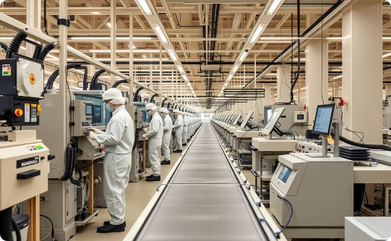
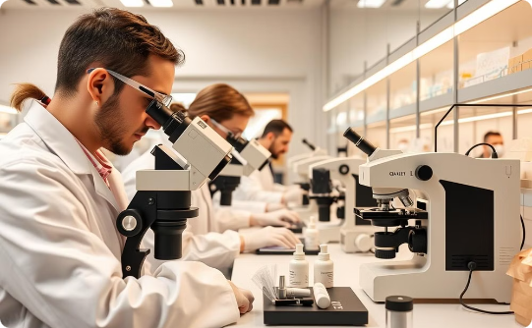
Producer View of Quality
Design & Development
Manufacturing & Production
Inspection & Testing
Good planning helps make better products. Teams work together to create designs that are easy to make and work well. Taking time to plan helps avoid problems later.
Regular product checks help find and fix problems. We test products to make sure they're safe and work well. Both people and machines check the products. Only products that pass all tests go to customers.
Making good products means following clear steps. Workers need proper training and good materials. Regular checks during production help catch mistakes early. Modern machines help make every product the same.

Slide 7

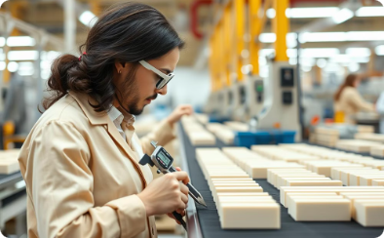


Various Costs of Delivering Quality
Prevention Costs
Appraisal Costs
Internal Failure Costs
External Failure Costs
Investment in training and proper equipment to stop problems before they happen
Regular quality checks and inspections during the production process
Resources spent fixing mistakes before products reach customers
Expenses related to handling customer complaints and product returns

Slide 8

Conclusion
Good quality doesn't happen by chance - it takes hard work from everyone. When we understand what makes things good and take the right steps to make them better, our business grows stronger and customers trust us more.

Slide 9
THANK YOU

